Slide 1
Otto Group Product Classification Challenge CS 6350- Big data Management and Analytics
Benny Stephen-bxm133230
Kiran kancheti-Kxk143630
Shashank adidamu-sxa145730
Nishanth Pininti-nxp141730

Slide 2
Problem Description: The Otto Group is one of the world’s biggest e-commerce companies, with subsidiaries in more than 20 countries. They are selling million of products world wide everyday, with thousand products being added to their product line. A consistent analysis of the performance of products is crucial. However, due to our diverse global infrastructure, many identical products classified differently. Therefore, the quality of product depends on the ability to cluster similar products accurately. The better the classification, the more insights we can generate about product range.

Slide 3
Data Set Description
A dataset with 93 features for more than 200,000 products. The objective is to build a predictive model which is able to distinguish all product categories.
File Descriptions:
train.csv - the training set
test.csv - the test set
Data Fields:
Id - an anonymous id unique to a product
feat_1,feat_2,feat_3……..feat_9 – the various features of a product.
target – class of a product.

Slide 4
INDUCTION
The main idea is to build a model using a training dataset, and then we will run our test data on the model generated from the training dataset, which would give us efficient classification of test data set.
test.csv
train.csv
result
Model

Slide 5
Models built
The model was build in Python using Machine Learning Libraries like scikit-learn. The different models build were:
Decision Tree classifier
Nearest neighbor
Support vector Machines
Naïve Based
Random forest

Slide 6
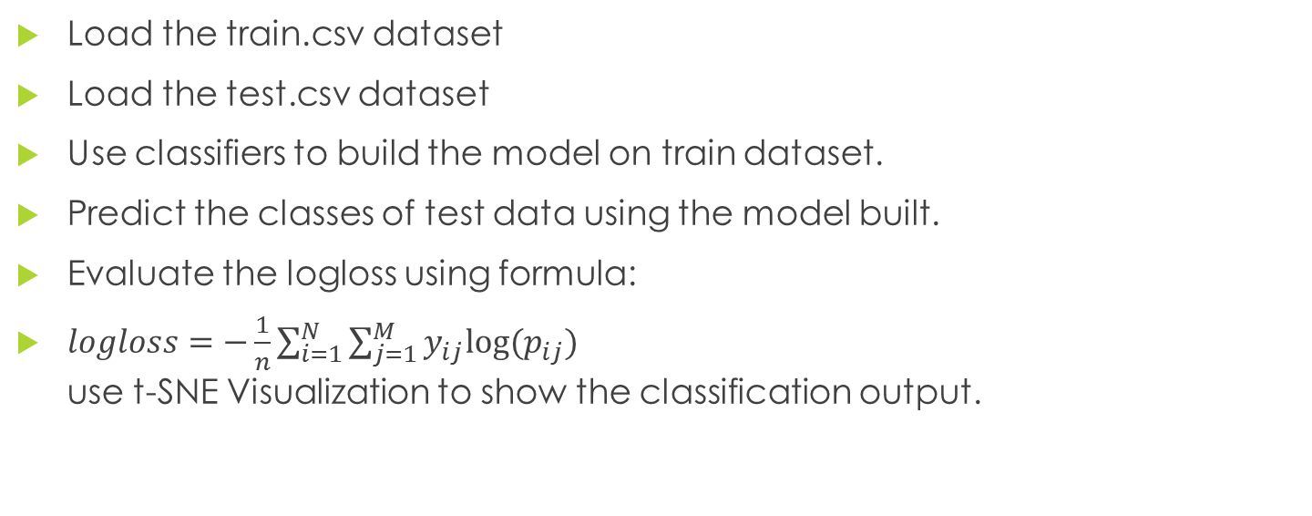
Pseudo Code
Load the train.csv dataset
Load the test.csv dataset
Use classifiers to build the model on train dataset.
Predict the classes of test data using the model built.
Evaluate the logloss using formula:
$logloss=−\frac{1}{n}\sum_{i=1}^{N}{\sum_{j=1}^{M}{y_{ij}log⁡(p_{ij}})}$ use t-SNE Visualization to show the classification output.

Slide 7
Technologies
spark: Initially spark was used to run scala programs but implementing detailed features was difficult in spark due to lack of open source machine learning libraries.
python: Scikit learn an open-source machine learning library was used to implement implement the various models.
R : t-SNE was used in R to get the visualization of the classification.

Slide 8
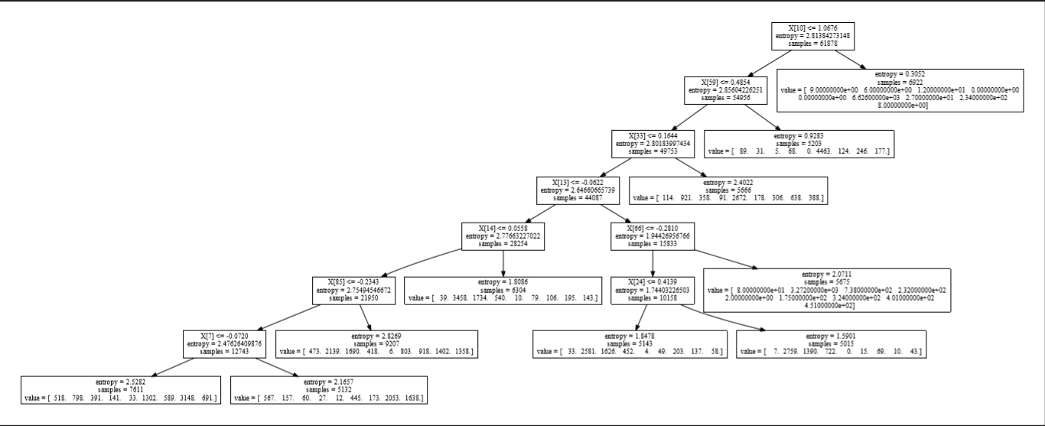
Decision Tree

Slide 9
Decision Tree
Decision Trees (DTs) are a non-parametric supervised learning method used for classification and regression. The goal is to create a model that predicts the value of a target variable by learning simple decision rules inferred from the data features.
As other classifiers, DecisionTreeClassifier take as input two arrays: an array X, sparse or dense, of size [n_samples, n_features] holding the training samples, and an array Y of integer values, size [n_samples], holding the class labels for the training samples:
>>> from sklearn import tree
>>> X = [n_samples, n_features]
>>> Y = [n_samples]
>>> clf = tree.DecisionTreeClassifier()
>>> clf = clf.fit(X, Y)
After being fitted, the model can then be used to predict the class of samples:
>>>
>>> clf.predict(Y_prob)
output

Slide 10
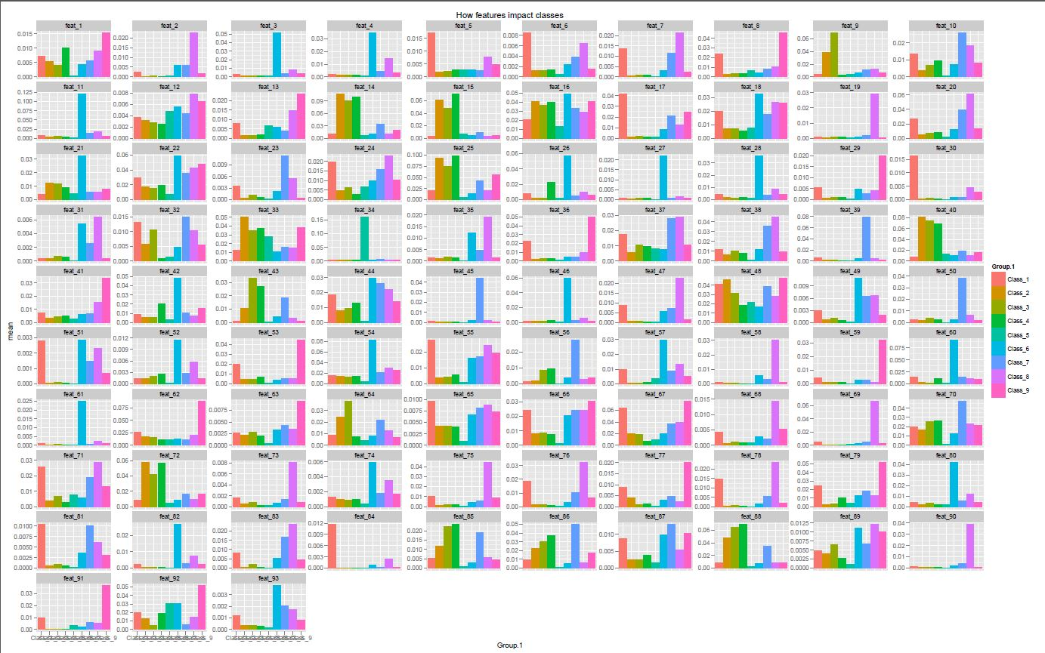
Decision Tree Classifier

Slide 11
Nearest Neighbor(K-NN)
Neighbors-based classification is a type of instance-based learning or non-generalizing learning: it does not attempt to construct a general internal model, but simply stores instances of the training data. Classification is computed from a simple majority vote of the nearest neighbors of each point: a query point is assigned the data class which has the most representatives within the nearest neighbors of the point.
The k-neighbors classification in KNeighborsClassifier is the more commonly used of the two techniques. The optimal choice of the value k is highly data-dependent: in general a larger k suppresses the effects of noise, but makes the classification boundaries less distinct
class sklearn.neighbors.KNeighborsClassifier(n_neighbors=5, weights='uniform', algorithm='auto', leaf_size=30, p=2, metric='minkowski', metric_params=None, **kwargs)

Slide 12
Support Vector Machines(SVM)
Uses a subset of training points in the decision function(called supprt vectors), so it is also memory efficient.
(C=100, cache_size=200, class_weight=None, coef0=0.0, degree=3, gamma=0.0001,
kernel='rbf', max_iter=-1, probability=True, random_state=None,
shrinking=True, tol=0.001, verbose=False)
Versatile: different Kernel functions can be specified for the decision function. Common kernels are
provided, but it is also possible to specify custom kernels.
SVMs decision function depends on some subset of the training data, called the support vectors

Slide 13
Naïve Based
Naive Bayes methods are a set of supervised learning algorithms based on applying Baye's theorem with the naive assumption of independence between every pair of features.Given a class variable y and a independent feature vector x1 through xn, Baye's theorem states the following relationship:
P(y|x1,..,xn)=P(y)P(x1,...,xn|y)/p(x1,...,xn).
GaussianNB implements Gaussian Naive Bayes algorithm for classification. The likelihood of the feature is assumed to be Gaussian.

Slide 14
Random Forest
A random forest is a meta estimator that fits a number of decision tree classifiers on various sub-samples of the dataset and use averaging to improve the predictive accuracy and control over-fitting.
class sklearn.ensemble.RandomForestClassifier(n_estimators=10, criterion='gini', max_depth=None, min_samples_split=2, min_samples_leaf=1, min_weight_fraction_leaf=0.0, max_features='auto', max_leaf_nodes=None, bootstrap=True, oob_score=False, n_jobs=1, random_state=None, verbose=0, warm_start=False, class_weight=None)

Slide 15
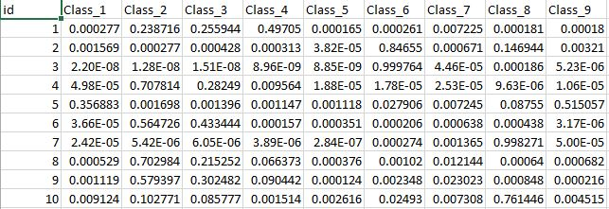
Testing
Test.csv when run on the model built would generate a submission.csv file which would show the class to which the product belongs to.
submission.csv snippet

Slide 16
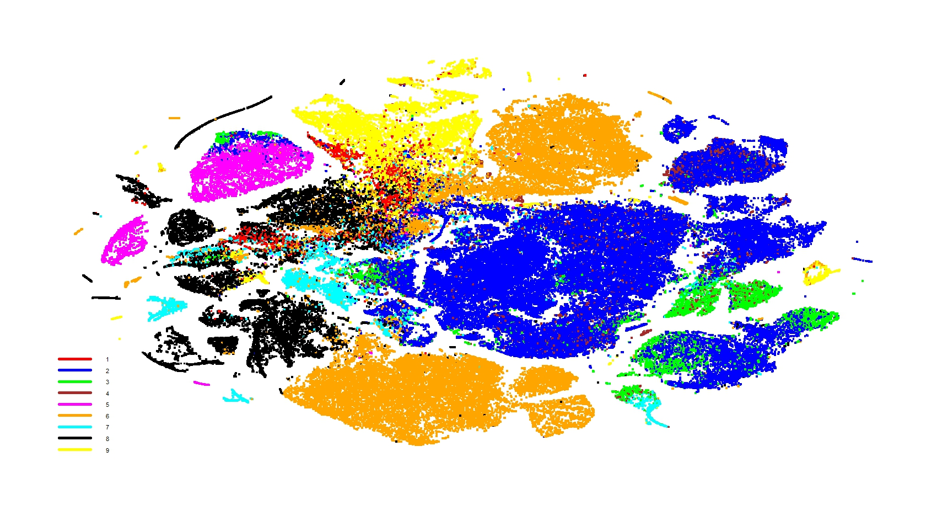
Visualization
Visualization was done using t-SNE visualization
SVM

Slide 17
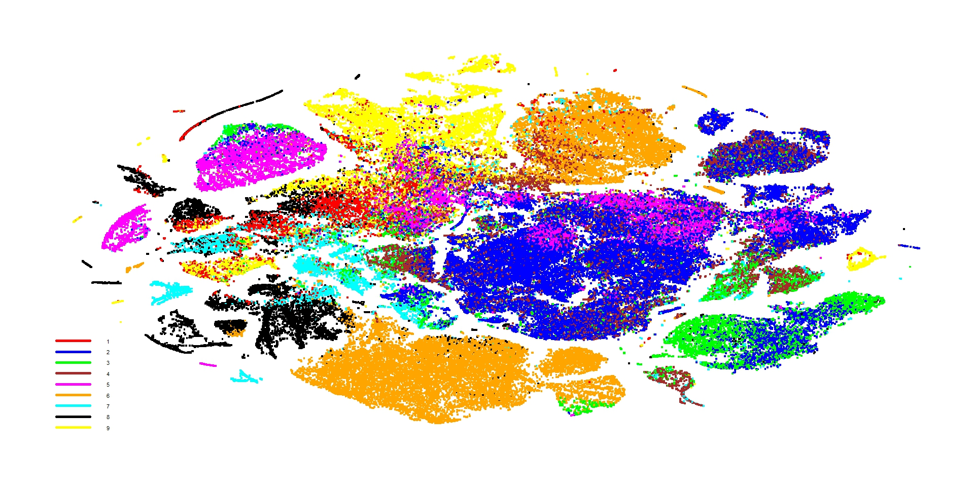
Visualization- naïve based

Slide 18
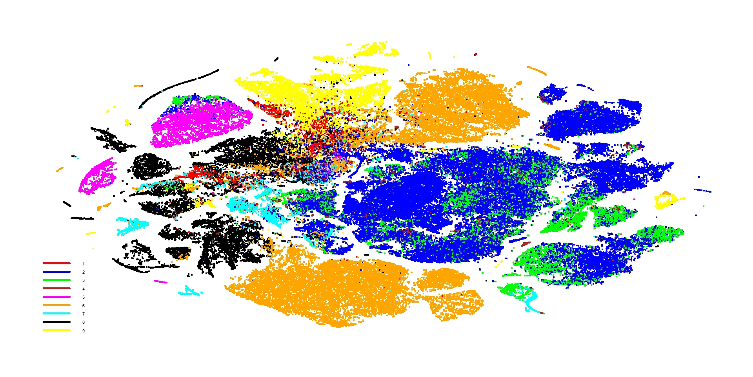
Visualization-K-nn

Slide 19

Visualization- Random Forest

Slide 20
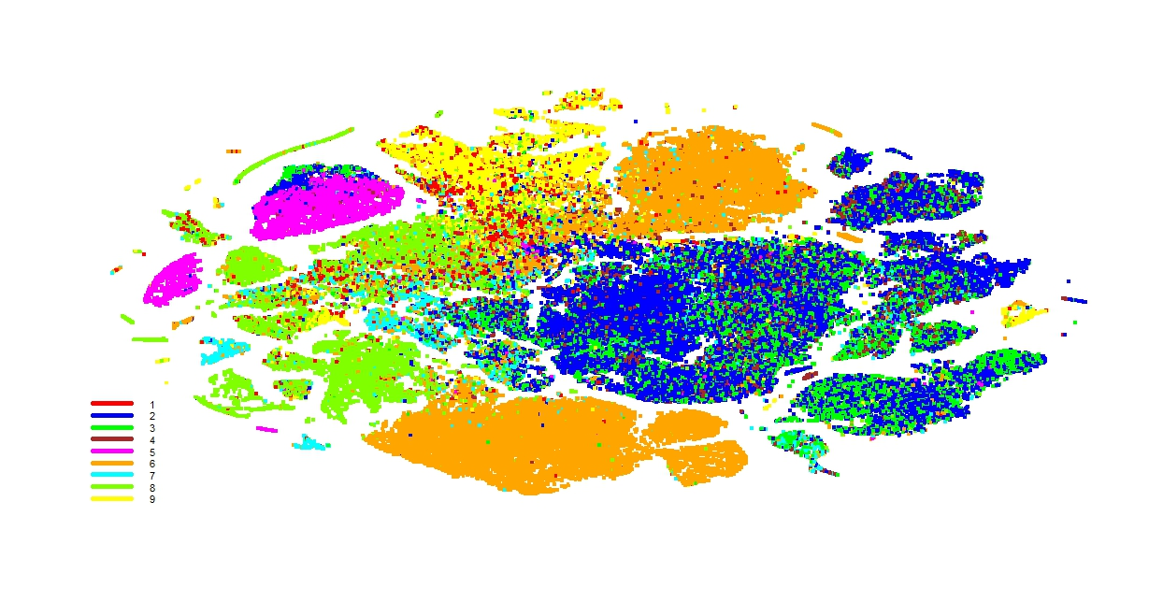
Visualization- Decision Tree

Slide 21
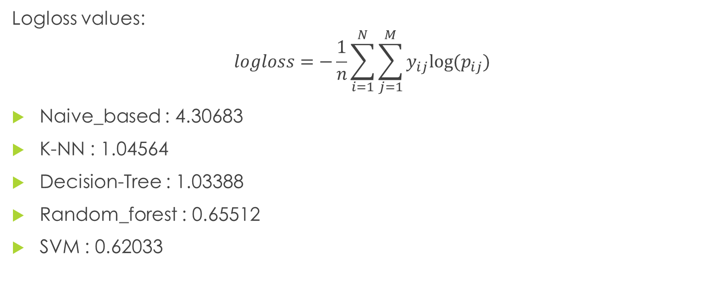
Conclusion
Logloss values:
$$logloss=−\frac{1}{n}\sum_{i=1}^{N}{\sum_{j=1}^{M}{y_{ij}log⁡(p_{ij}})}$$
Naive_based : 4.30683
K-NN : 1.04564
Decision-Tree : 1.03388
Random_forest : 0.65512
SVM : 0.62033

